Slide 1
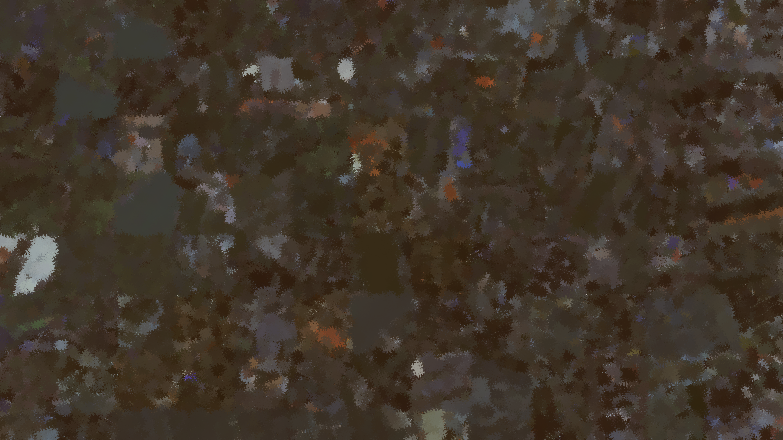
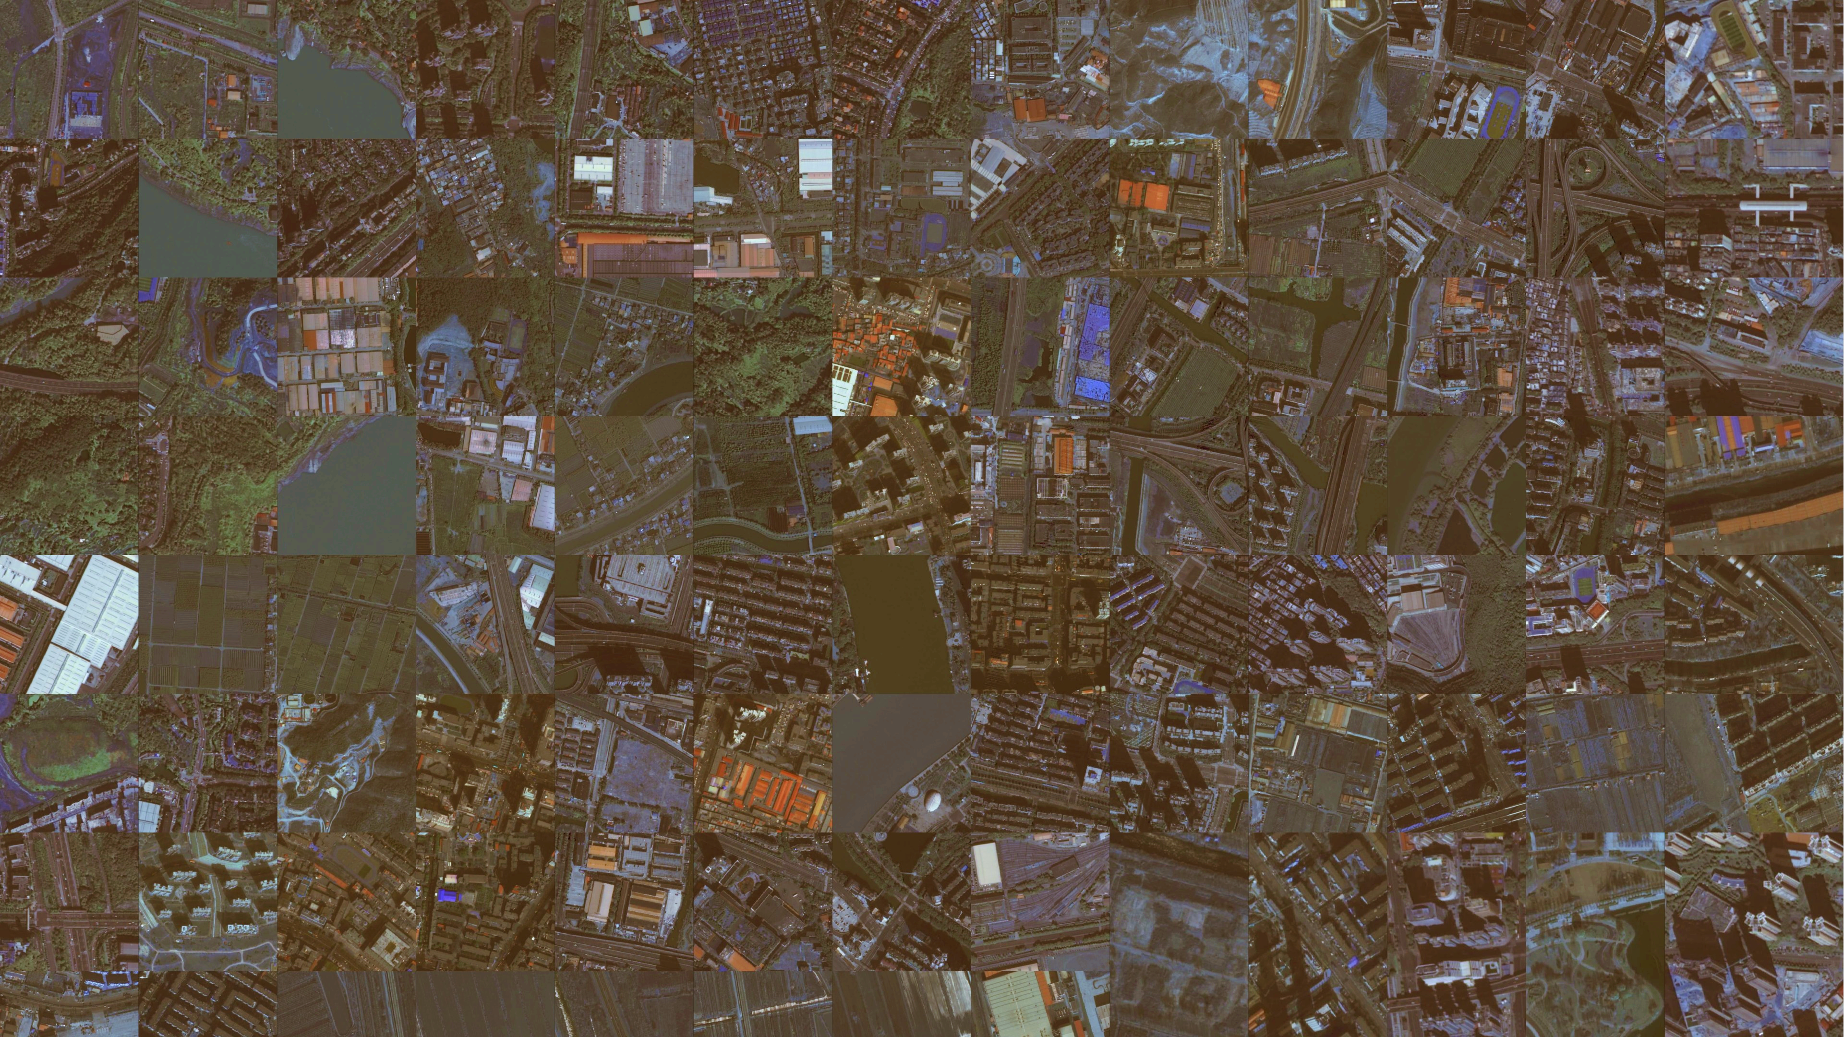
Hybrid ViT - U-Net for Building Segmentation from Satellite Imagery
Final Project Presentation
Irti Haq, Youngkyu Ko,
Xunan Li
Notes:
“Hi everyone, good evening,
Today, we are going to present our project "Vision Transformer U Net for building segmentation form seattliete imagery"
My name is Youngkyu. I'm here with Xunan and Irti.

Slide 2
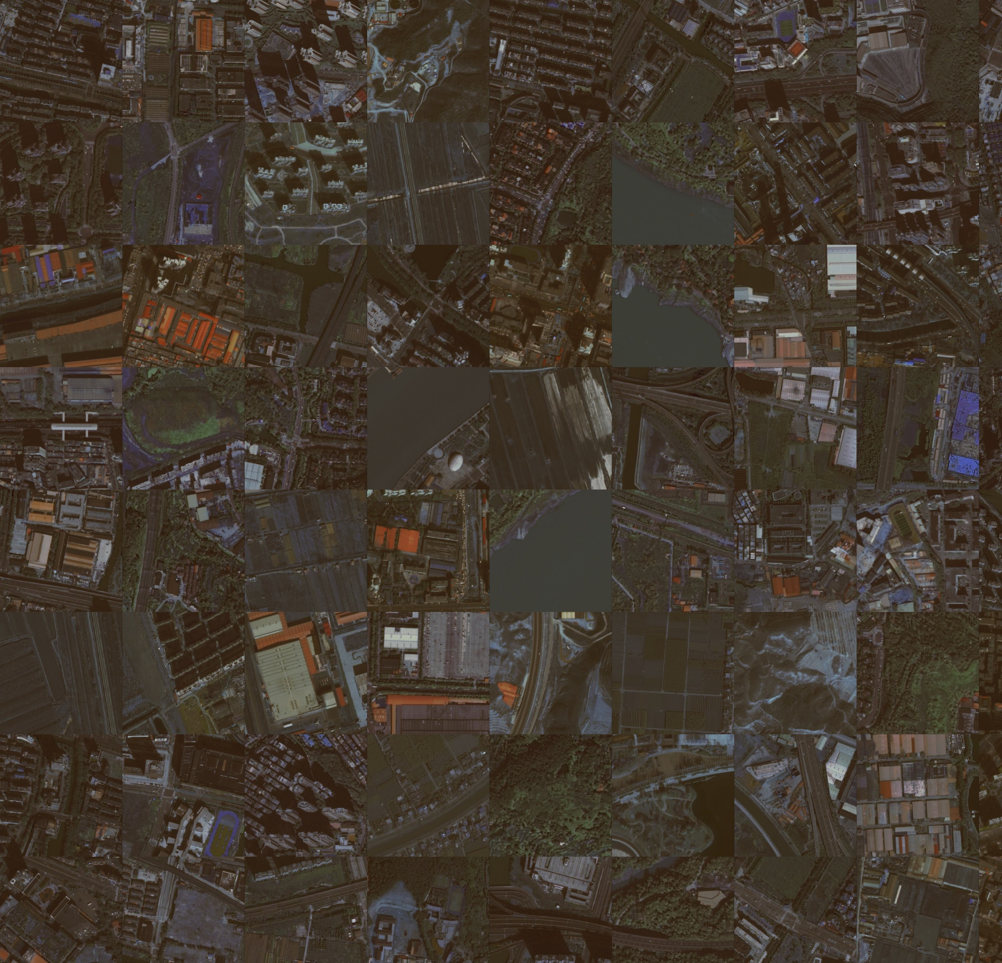
Overview
Motivation and Question
Related work
Data
Approach
Experiments
Results
Findings and insights
Limitations and future work
Conclusion
Notes:
Here’s a quick overview of what we’ll covering today:
First, we will start with some motivation, research questions and related work.. And the dataset we ued.
And we will go over actual model building part. And then we’ll go over some finding, insights and limitation and future work.
And we’ll finalized with conclusion

Slide 3

Motivation
Accurate building segmentation in satellite imagery can play an essential for:
Disaster response & humanitarian aid
Urban planning & infrastructure development
Population mapping & sustainability tracking
But... existing methods often:
Struggle in rural/underrepresented areas
Are biased toward urban imagery
Miss fine-grained boundary details
Notes:
Let me quickly go over our motivation for this project.
So why does building segmentation from satellite imagery matter?
It’s critical for a lot of real-world tasks such as disaster response, urban planning, and population mapping.
But existing models still have problems
Many struggle with rural areas or under-presented regions
They tend to be biased toward urban settings
And they often miss boundary details, especially when buildings are small or close together
With better satellite data now available, we wanted to ask question:
can we do better by combining the strengths of different models?

Slide 4
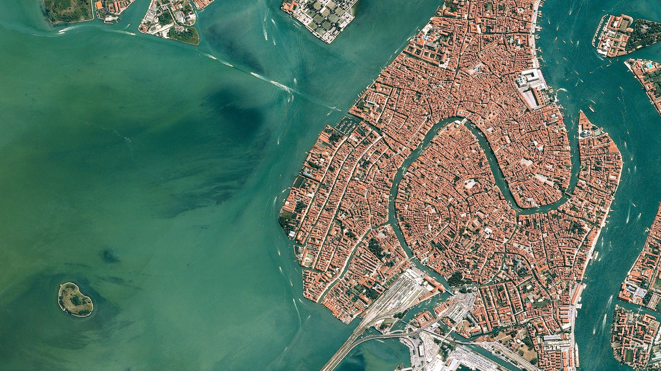
Research Question
“Can a Hybrid ViT + U-Net model achieve high segmentation accuracy and low boundary error for building segmentation across diverse urban environments?”
Notes:
That leads us to our main research questions
“Can a hybrid ViT + U-Net Model achieve high segmentation accuracy and low boundary error across diverse urban environement”
In other words, can we build a model that not only detects buildings well, but also works across different setting-rural and urban.

Slide 5
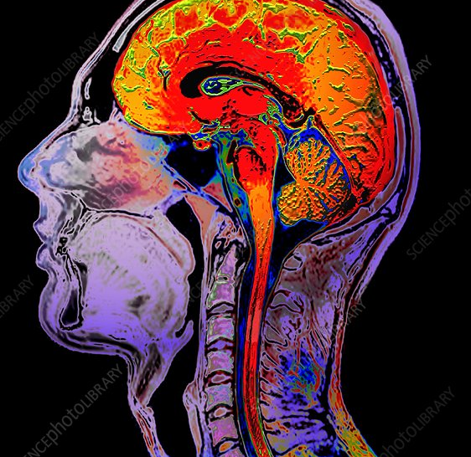
Related work
CNN-based models like U-Net: Excels at local detail, weak at global context
Vision Transformers (ViT): Strong at global dependencies, but heavy and data-hungry
TransUNet (Chen et al., 2021): Combines ViT + U-Net Like Model
→ Used for medical image segmentation → We adapted and extend TransUNet for building segmentation from satellite data.
Demir, I., Koperski, K., Lindenbaum, D., Pang, G., Huang, J., Basu, S., ... & Raska, R. (2018). "DeepGlobe 2018: A Challenge to Parse the Earth Through Satellite Images."
Comments: This paper introduces a benchmark for satellite image understanding, including building detection using CNN-based approaches.
Dosovitskiy, A., et al. (2020). "An Image is Worth 16x16 Words: Transformers for Image Recognition at Scale."
Comments: This foundational paper introduced Vision Transformers and their ability to outperform CNNs on image classification tasks, motivating their application to dense prediction problems like segmentation.
Mou, L., et al. (2022). "Vision Transformers for Remote Sensing Image Understanding: A Comprehensive Review."
Comments: This review highlights the emerging use of Vision Transformers in remote sensing, including classification and segmentation, and underscores the need for more hybrid approaches.
Notes:
For the model that we used to work on the project are based on CNN and Transformers
U-Net is very good at capturing local details, which is useful for segmenting small building.
Vision Transformers are better at understanding the global context of an image , but they require more data and are harder to train.
We were inspired by TransUNet, a model that combined both. It was originally used for medical imaging, but we adapted and modify it for satellite data

Slide 6
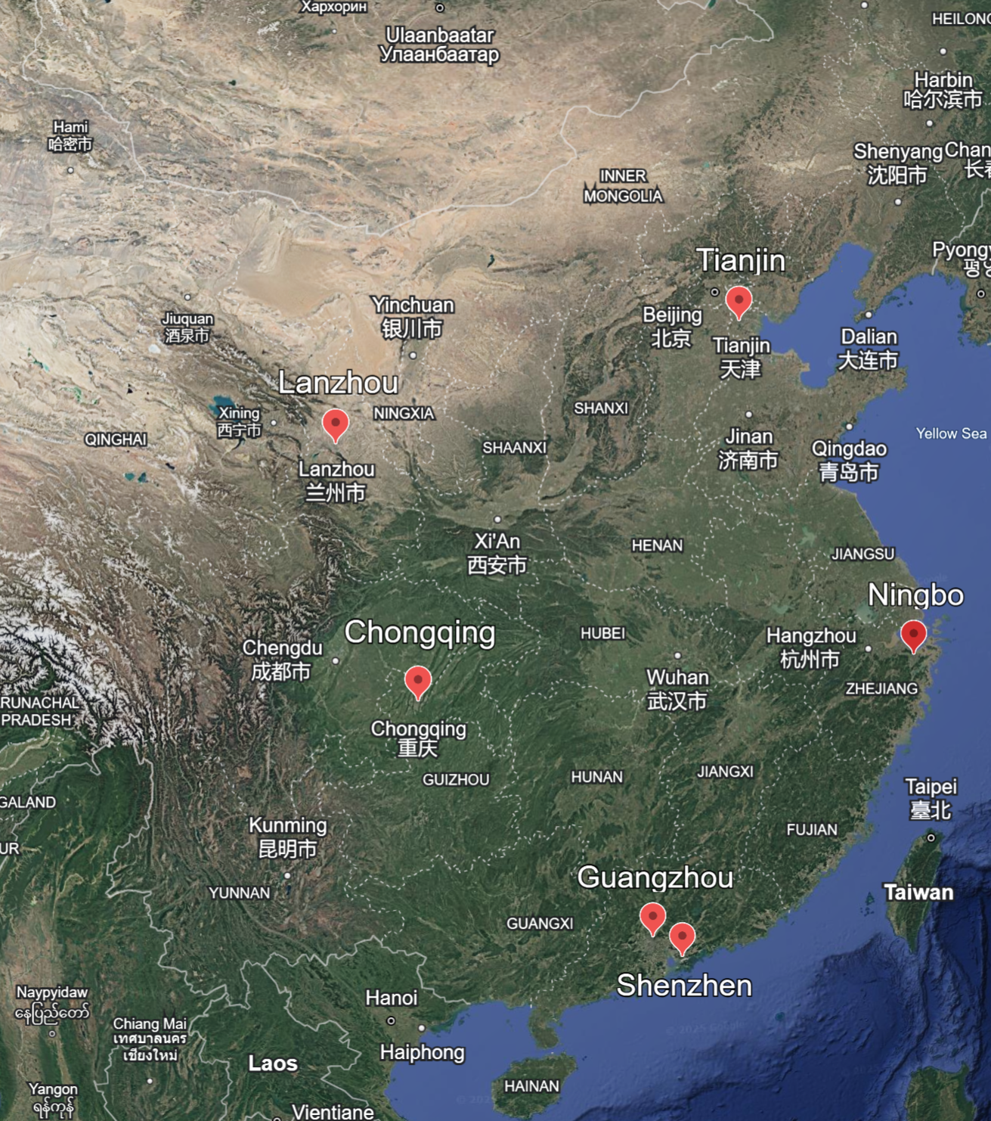
Dataset
Source: Chinese GaoGen-7 satellite images
6 diverse cities across China (urban + rural)
5,175 image-label pairs, 170,015 buildings
Image size: 512×512 pixels
Feature: High-resolution, Ground-truth quality, Urban-rural diversity
84.8% of the buildings in urban areas and 15.2% in rural areas.
Chongqing, Guangzhou, Lanzhou, Ningbo, Shenzhen, Tianjin
Notes:
Moving on the Dataset
Our dataset comes from the GaoFen-7 satellite, which provides high-resolution images of six cities in China-both urban and rural area
The dataset includes:
5175 image-label pairs
Covering over 170,000 buildings
With each image sized at 512 by 512 pixels
One thing we like about this dataset is its diversity:
around 85% of buildings are urban, and 15% are rural, which allowed us to test the model across different types of environments.

Slide 7
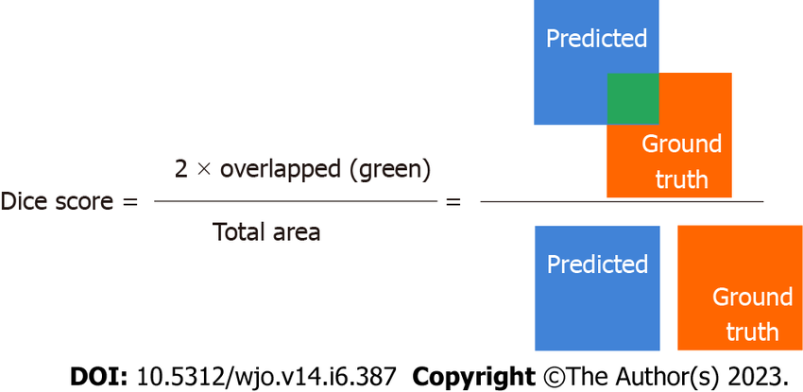
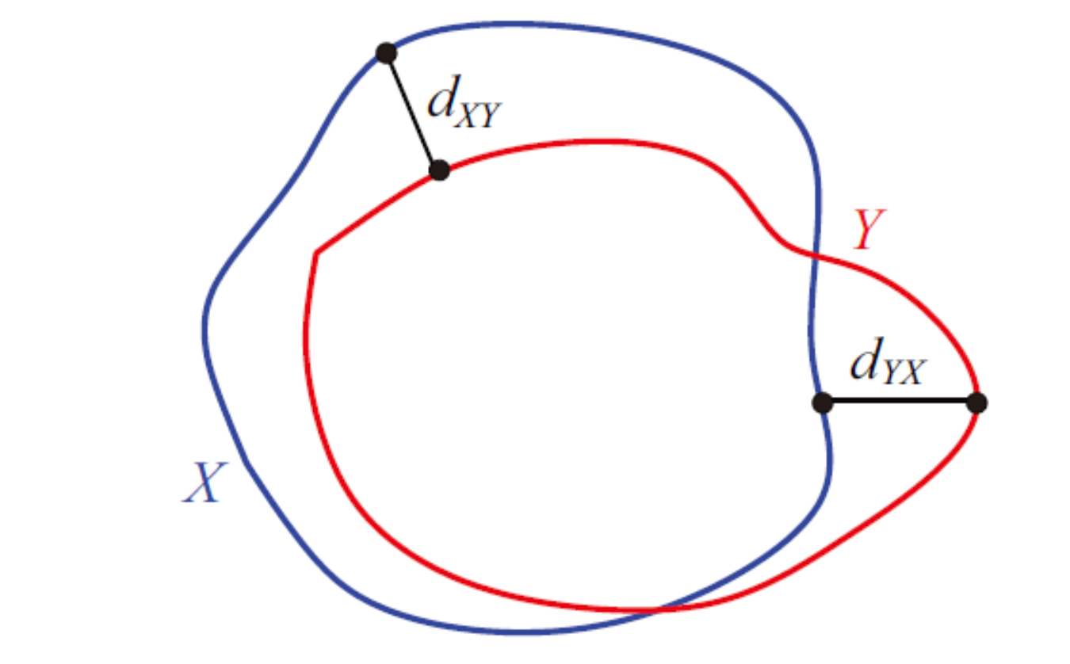
Evaluation Metrics
Average DICE Score (F1 Score): high value = better
Overlap between predicted and actual masks
0: No overlap, 1: indicating perfect overlap
HD95 (Hausdorff 95): low value = better
Maximum distance of a set to the nearest point
Measures how far the boundaries of predictions are from the true edges
-> Robust against outliers
Notes:
To evaluate our model’s performance, we used two main metric: Dice Score and HD95
First Dice score, also known as the F1 score, measures how well the predicted building masks overlap with the actual labels. A score of 1 means perfect overlap.”
HD95, measures how far the predicted boundaries are from the actual ones. The lower the value, the better. It’s also robust to outliers, with makes it useful in noisy complex regions.
Together, These metrics helped us evaluate both the accuracy and precision of our segmentation results

Slide 8
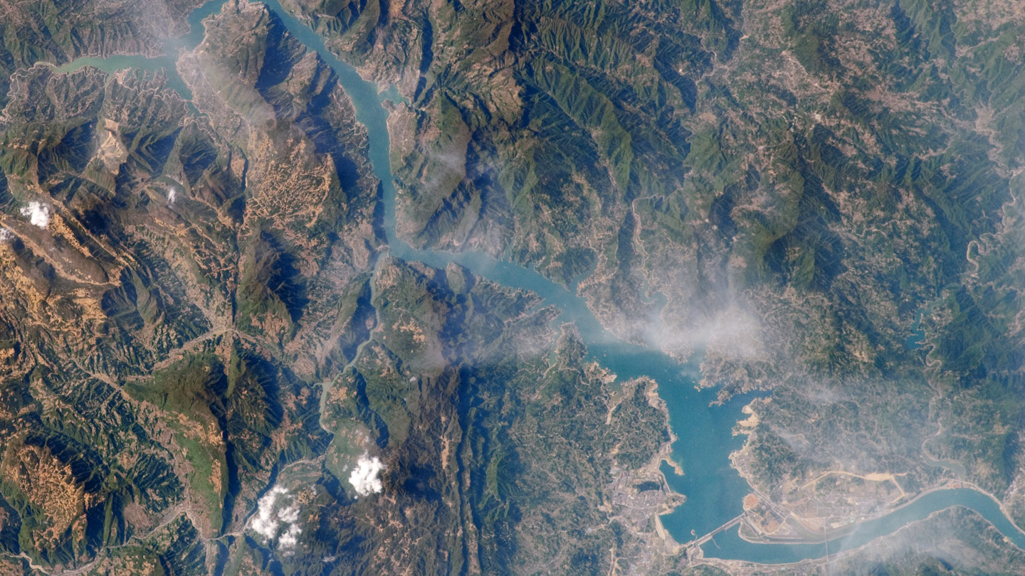
Our Approach
Hybrid ViT + U-Net Model

Slide 9
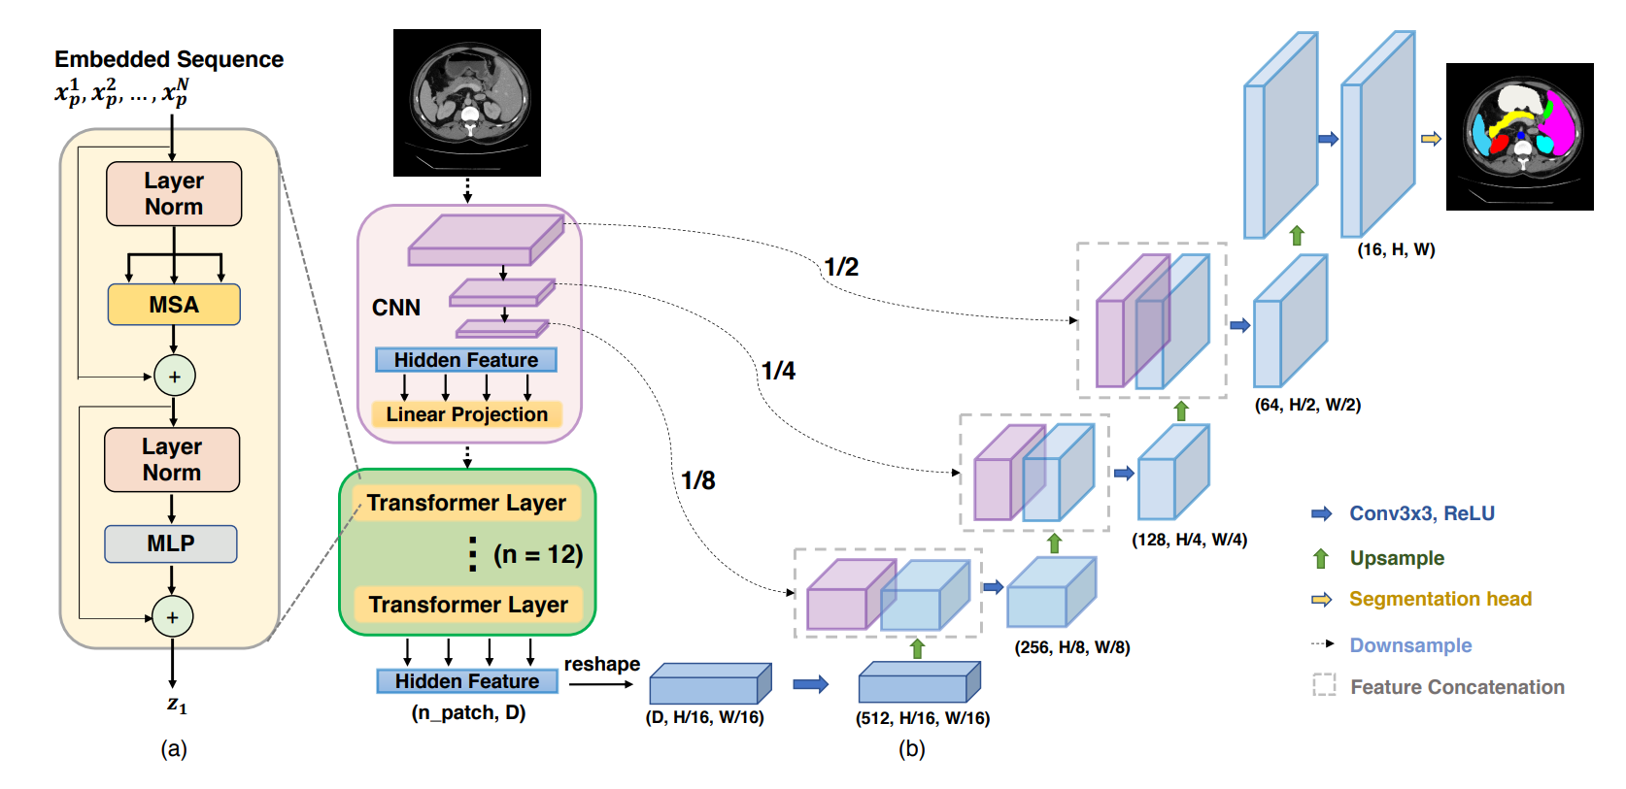

Slide 10
TransUNet For Medical Image Segmentation

Slide 11
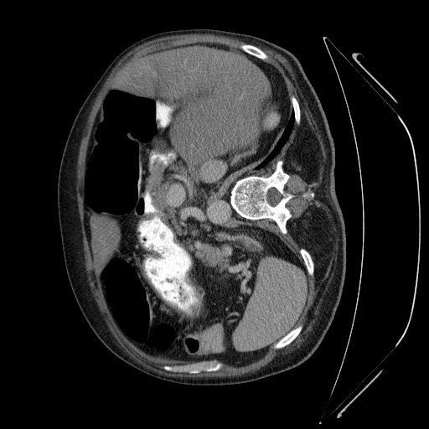
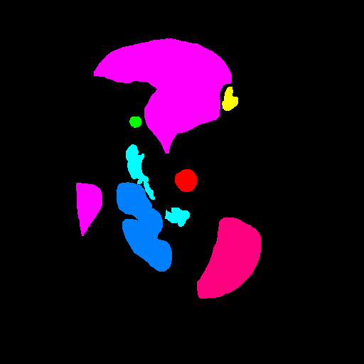
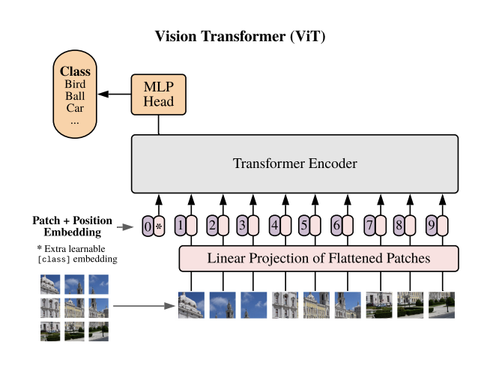
What is TransUNet
A state-of-the-art medical image segmentation model that combines the strengths of Transformers and U-Net (CNN). Our project adapts this for satellite imagery.
Designed to capture both global, long-range dependencies (via Transformers) and local, fine-grained details (via U-Net).
Core Components:
CNN Backbone (Encoder): Model uses a ResNet-50 based backbone (R50-ViT-B_16) as part of the Vision Transformer (ViT) encoder.
Transformer Encoder: The feature maps are processed by a Vision Transformer (Pretrained ViT-B_16 From Google) which tokenizes image patches (16x16) and uses self-attention mechanisms to learn global relationships.
Decoder (CNN-based): A U-Net-like decoder architecture with skip connections upsamples the features to produce the segmentation map. It uses skip connections from multiple resolution stages of the CNN backbone.
Segmentation Head: A final convolutional layer outputs the pixel-wise segmentation map
Human Abdomen Scan
Notes:
The Trans-UNet uses ResNet-50 as its backbone to get the feature map which is then used to form patches as the input of Vision Transformer , feature extraction ( a part of the network that "sees" the input), and processes input data into a certain feature representation

Slide 12
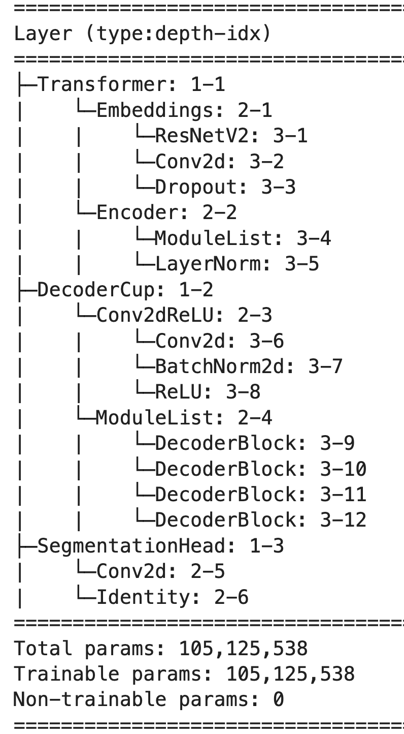
Our Model: VIt-UNet Hybrid
Most of the Code and Architecture for the Model has been directly taken from the TransUNet project by Chen et al. (2021) and then adapted to be used for building Segmentation.
Our Model has Been adapted to perform building segmentation from Chinese GaoFen-7 (GF-7) satellite imagery.
The primary goal is to achieve high segmentation accuracy (Dice score) and low boundary error (HD95) across diverse urban areas.

Slide 13
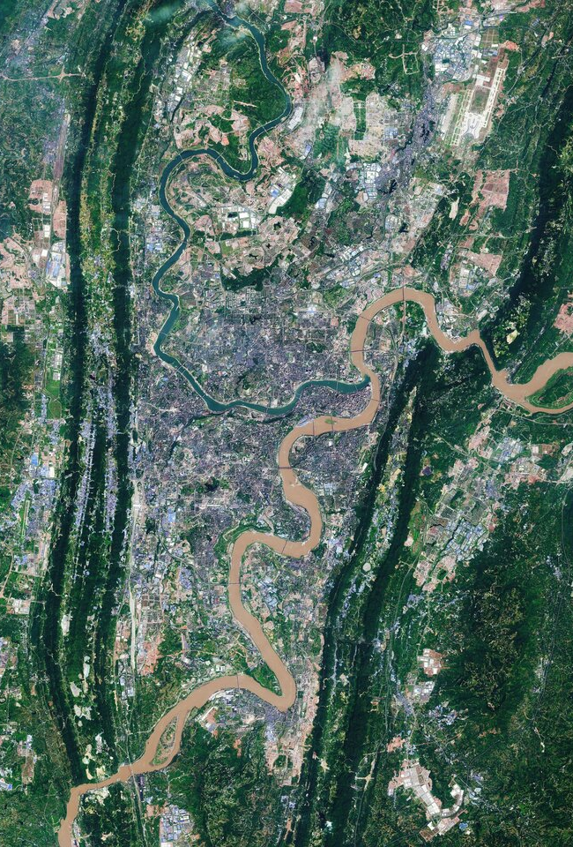
Key Changes Made to The Model
Optimizers:
SGD with Momentum → Adam → AdamW → AdamW + AMSGrad
Improved convergence, Adding AMSGrad in particular helped enhance convergence
Scheduler:
Original Model used of polynomial learning rate decay: led to inconsistent convergence behavior and slower training progress, particularly in the early epochs
Replaced polynomial decay with CosineAnnealingWarmRestarts
Smoother, adaptive learning rates & resulted in faster convergence, reduced training time, and improved overall stability
Data Augmentation:
Started with strong augmentations → poor results
Final: A Moderate data augmentation pipeline using Albumentations, which applies a combination of geometric transforms (rotation, flips) & various color augmentations (like brightness, contrast, and color shifting), and multiplicative noise.
Tuning:
Batch size, learning rate, training epochs, skip connections
Chongqing, China
Notes:
AdamW: A variant of the Adam optimizer that decouples weight decay from gradient updates, leading to better generalization in deep learning models.
AMSGrad: A modification of Adam that ensures stable convergence by using the maximum of past squared gradients instead of an exponentially weighted average.
CosineAnnealingWarmRestarts: A learning rate scheduler that periodically reduces the learning rate following a cosine curve and then restarts it, helping models escape local minima and improve convergence.

Slide 14
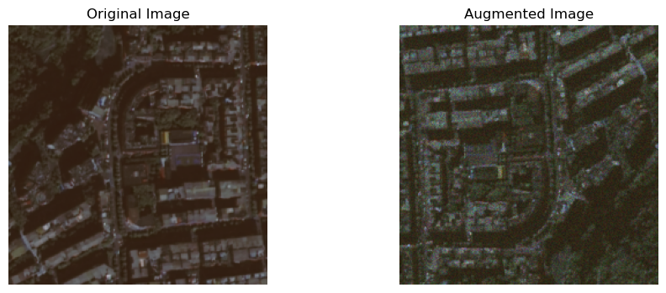
Data Augments
RandomRotate90: Rotates by 90, 180, or 270 degrees with a 0.5 probability.
HorizontalFlip: Flips horizontally with a 0.5 probability.
VerticalFlip: Flips vertically with a 0.5 probability.
SomeOf (applies 2 of the following with a 0.8 probability):
RandomBrightnessContrast: Adjusts brightness and contrast within a 0.1 limit.
RGBShift: Shifts R, G, and B channels within an 8 limit.
HueSaturationValue: Shifts hue within a 5 limit, saturation within an 8 limit, and value within a 5 limit.
RandomGamma: Applies gamma correction within a (90, 110) range.
OneOf (applies 1 of the following with a 0.4 probability):
MultiplicativeNoise: Applies multiplicative noise with a multiplier range of (0.7, 1.2), per-channel, and elementwise.

Slide 15
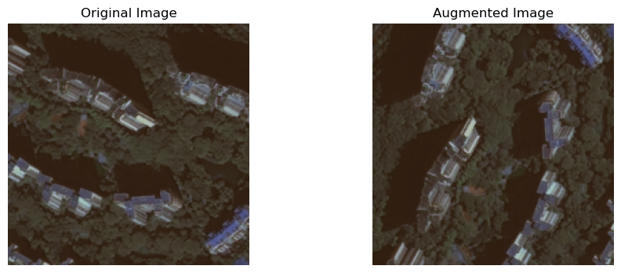
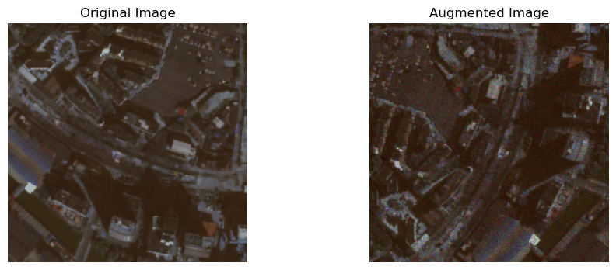
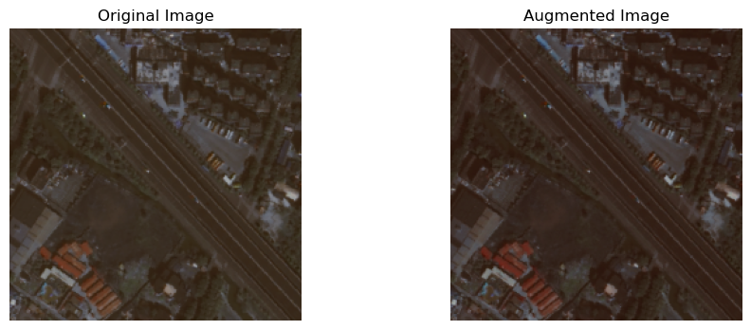
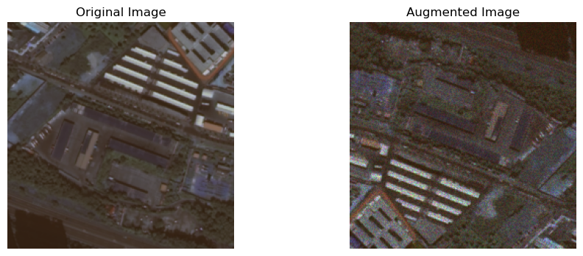

Slide 16
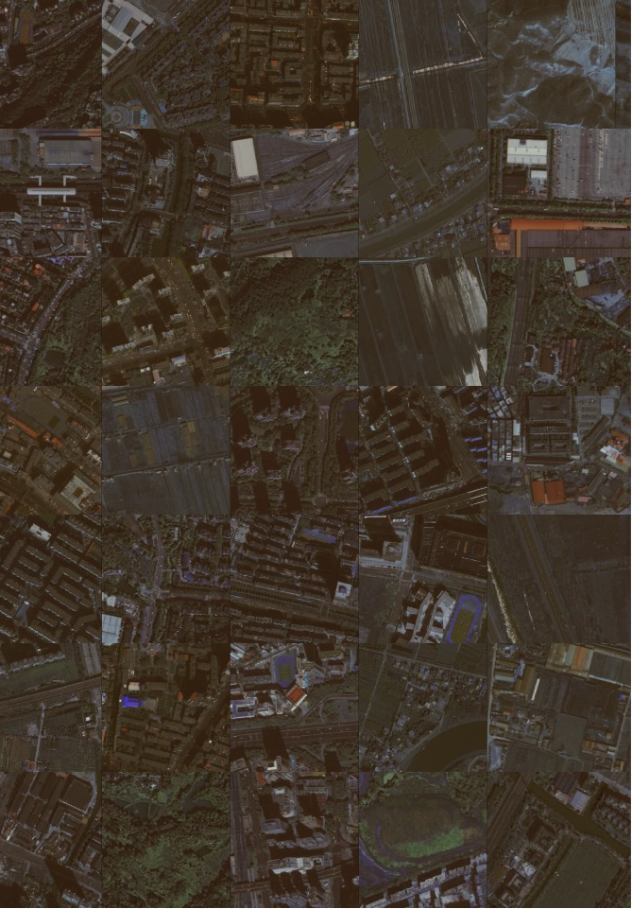
Quick Overview of The Model Parameters
Dataset: Chinese GaoFen-7 (GF-7) satellite imagery dataset.
Total Images: 5175 = Training: 3106 images + Validation: 1034 images + Test: 1035 images
Number of Classes = 2 Building vs. Background
Image Size : 224 X 224 , Patch Size = 16 X 16
Augments Used: Geometric Transforms, Color Augments, & Multiplicative Noise
Device: GPU (Cuda)
Optimizer: AdamW + AMSGrad
Learning Rate Scheduler: CosineAnnealingWarmRestarts
Base Leering Rate: 0.001
Loss Function: Dice + CrossEntropy (CE)
Batch Size: 25
Number of Epochs: 94
Images from Dataset

Slide 17
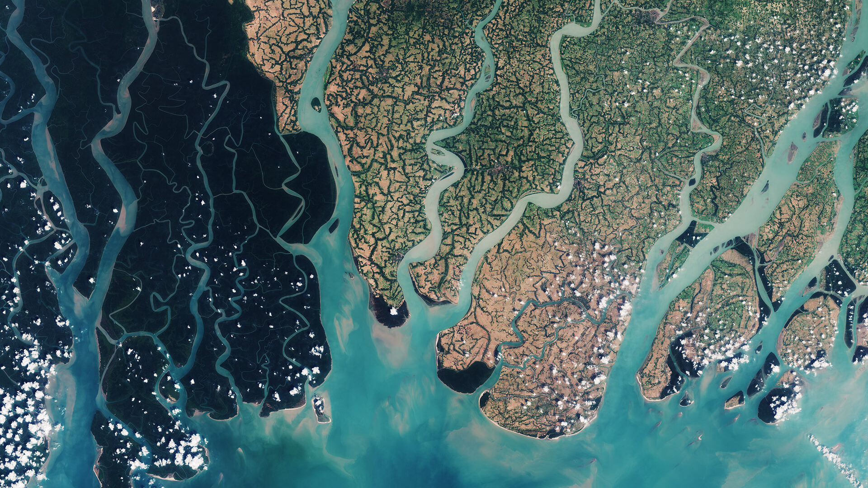
Results
VIT + U NET

Slide 18
Model Final Test Scores
Q3
Q1

Slide 19
Comparing our DICE / F1 Score Against Other Models
Source: Han, R., Fan, X., & Liu, J. (2024). EUNet: Edge-UNet for Accurate Building Extraction and Edge Emphasis in Gaofen-7 Images. Remote Sensing, 16(13), 2397.

Slide 20
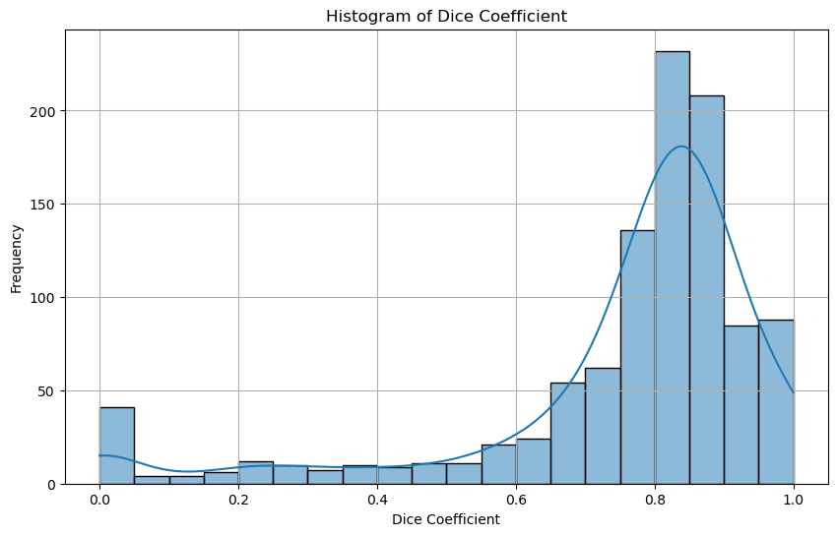
Histogram of Dice Coefficients
Distribution Shape: Left Skewed and with a Long Tail of Error and the majority of the Dice Coefficients concentrated at the higher end (roughly 0.7 to 1.0).
Peaks around 0.8 (Median)
Small Bump in the Dice Coeffect at Zero suggesting there might be a small subset of images where the model has extremely poor performance

Slide 21
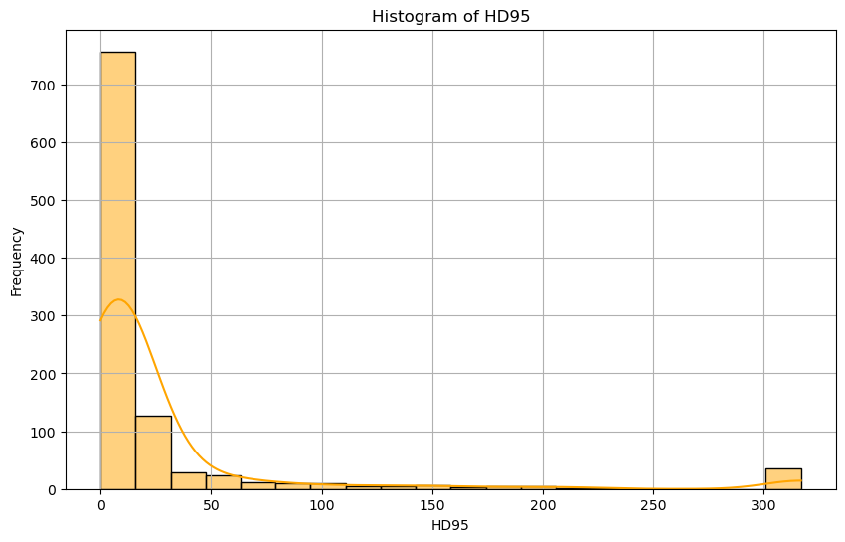
Histogram of HD95 Scores
Distribution Shape: Righed Skewed and with a extremely Long Tail of Error Highlighting the presence of a significant number of Edge Cases
Most predictions falling under 10 pixels of boundary error
Significant Number of Extreme cases with more than 100
At Max Distance
316.8

Slide 22
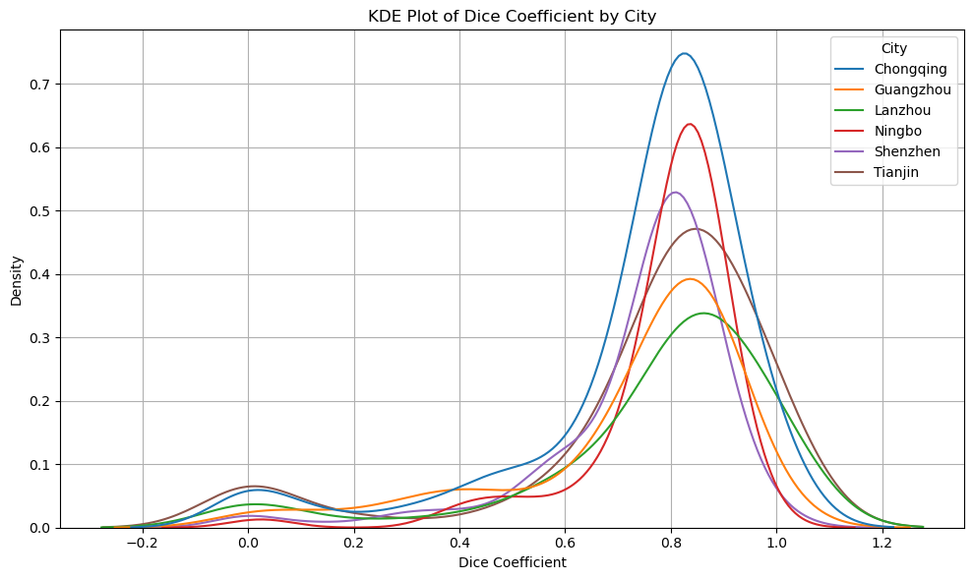
Differences in Performance Across Different Cities
City | Dice Coefficient Mean | Dice Coefficient Std | HD95 Mean | HD95 Std
Chongqing | 74.4% | 22.3% | 26.69 | 59.48
Guangzhou | 72.3% | 22.8% | 29.42 | 56.69
Lanzhou | 76.7% | 25.0% | 33.31 | 74.00
Ningbo | 78.5% | 14.7% | 15.57 | 23.42
Shenzhen | 74.3% | 17.7% | 23.65 | 51.72
Tianjin | 75.3% | 26.3% | 34.51 | 79.73
Overall | 75.2% | 22.1% | 27.42 | 61.27

Slide 23
Map of China For Reference

Slide 24
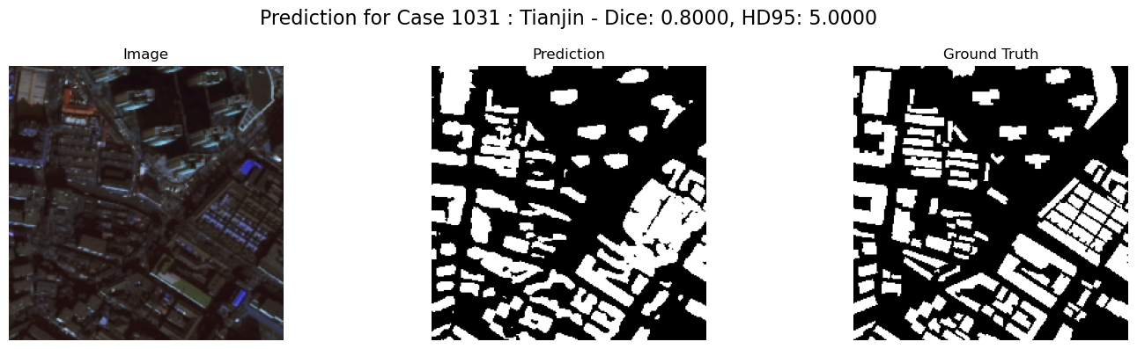
Example of Predicted Mask

Slide 25
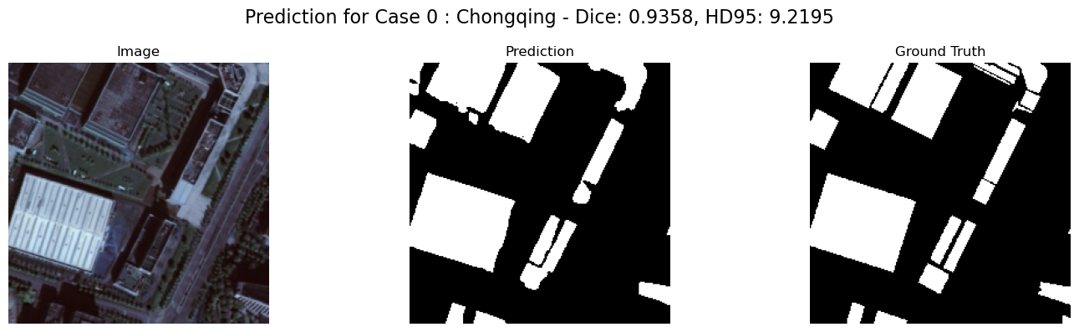
Example of Predicted Mask

Slide 26
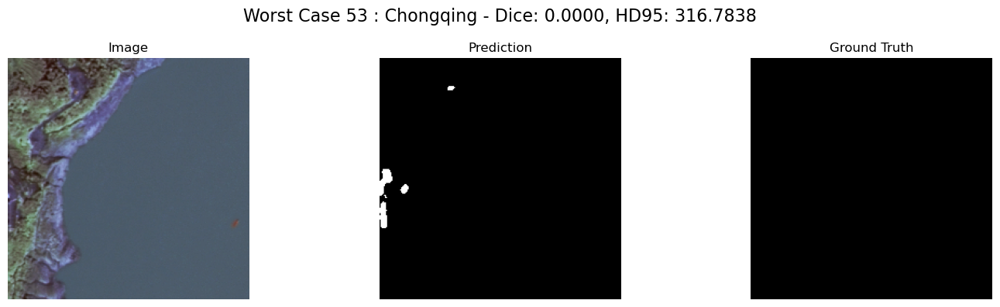
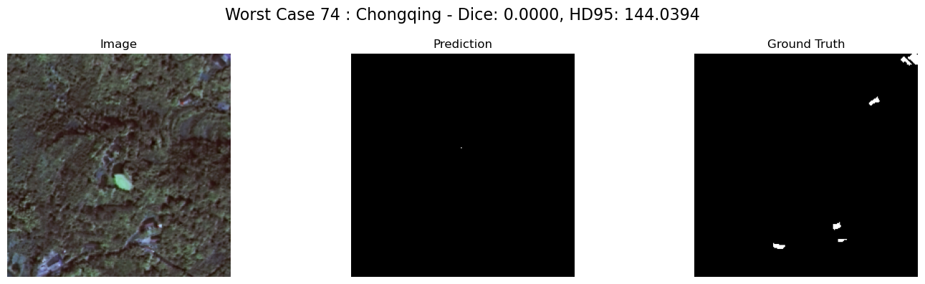
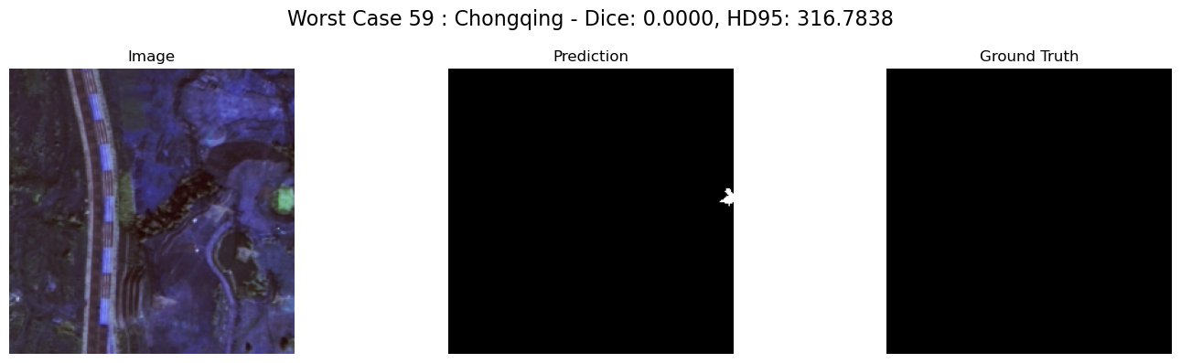
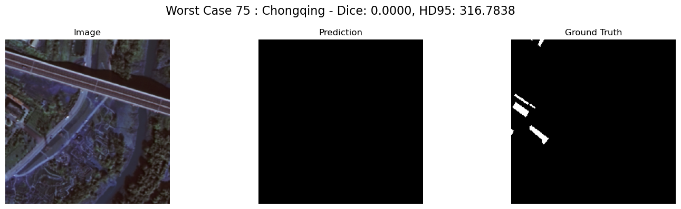
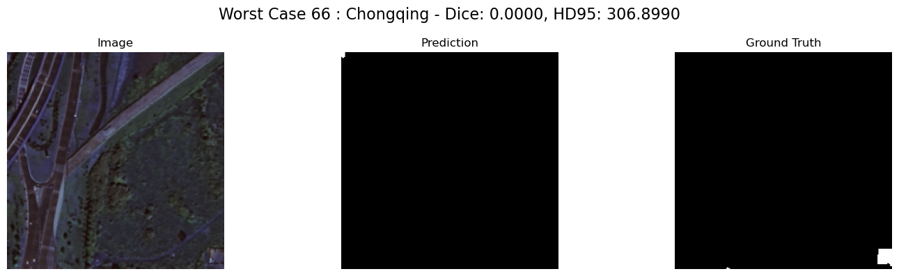
DICE Scores of 0

Slide 27
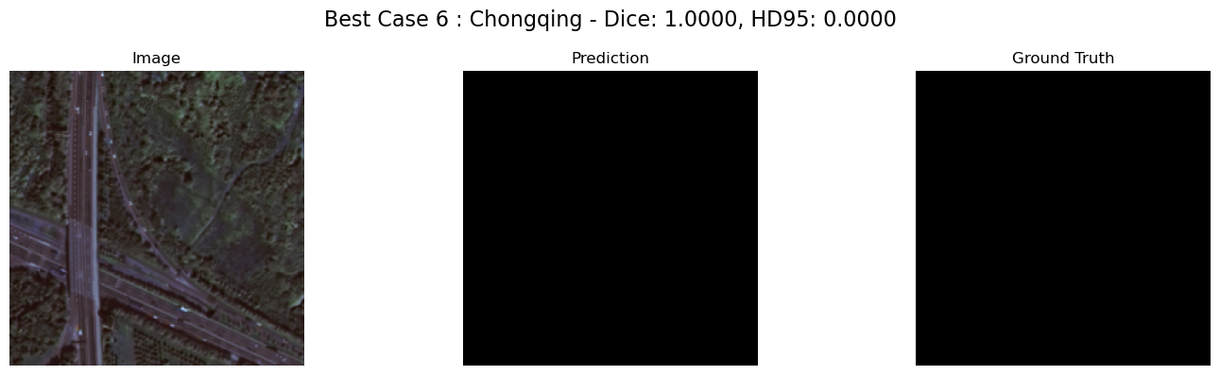
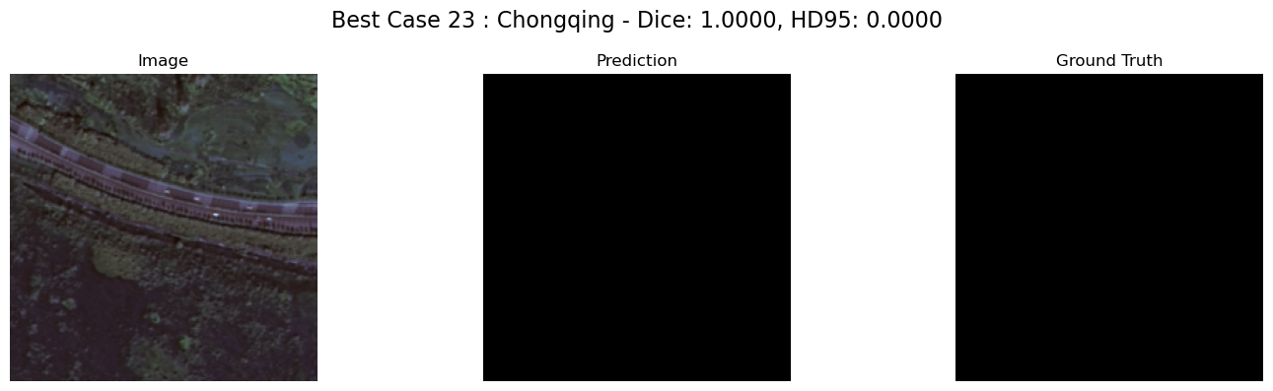
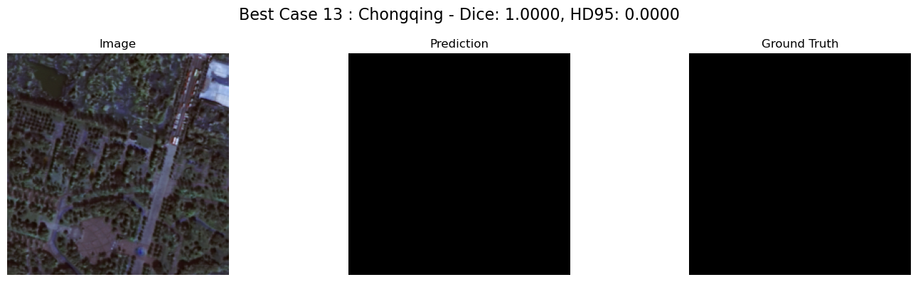
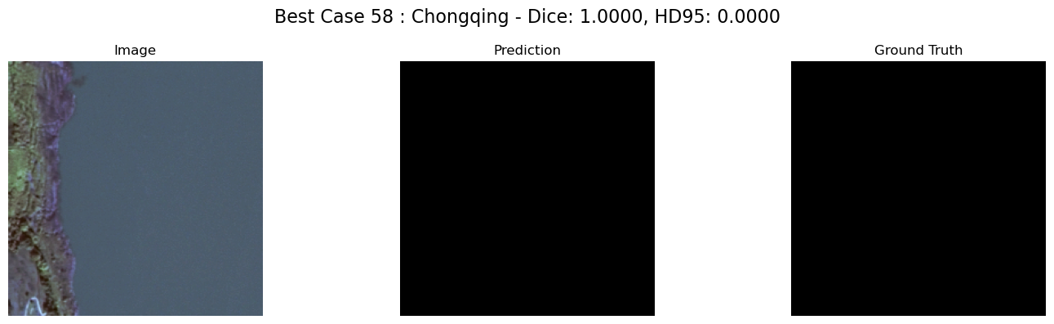
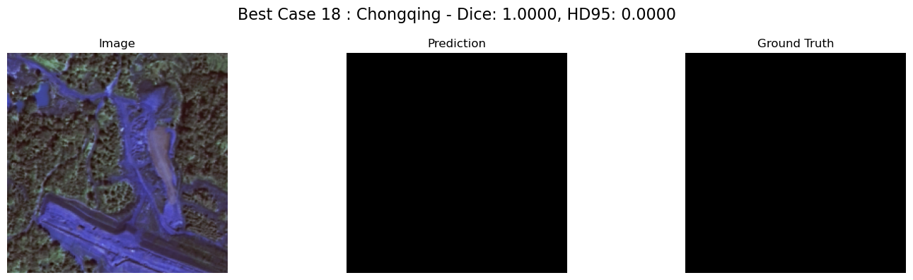
DICE Scores of 1

Slide 28
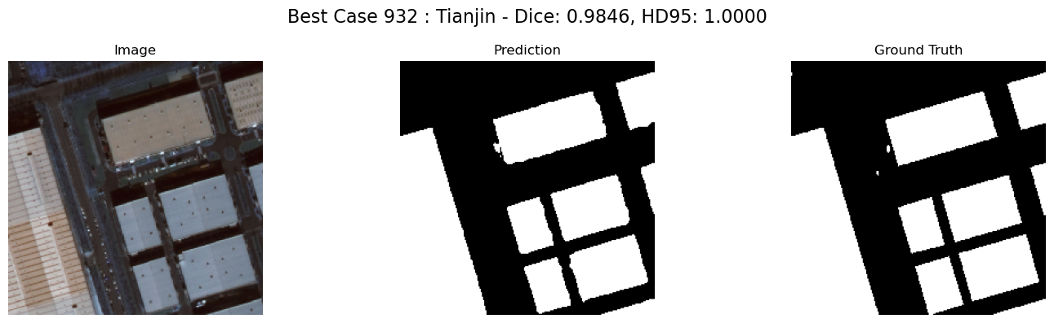
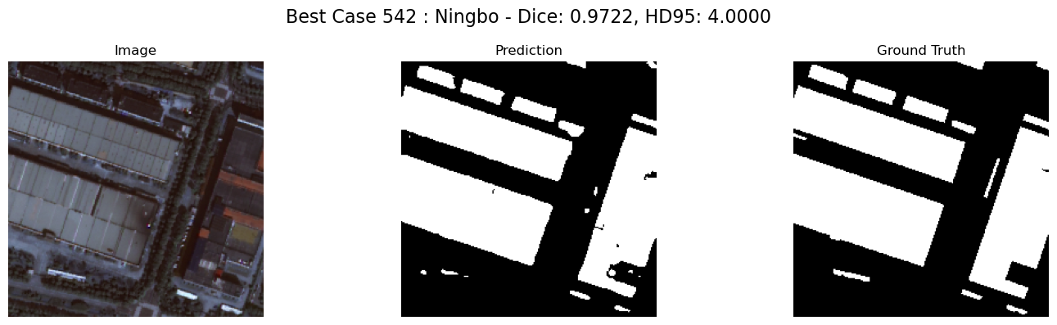
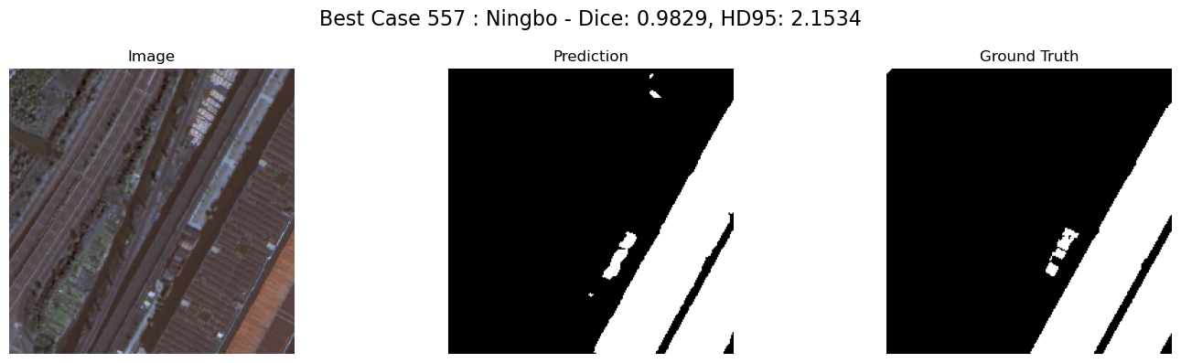
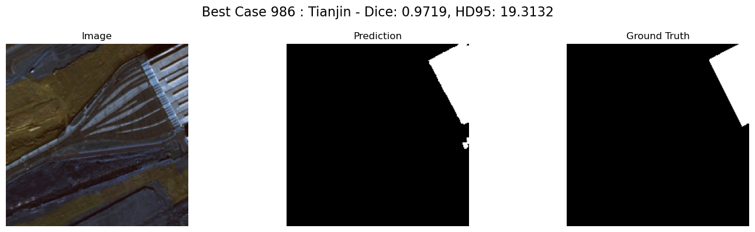
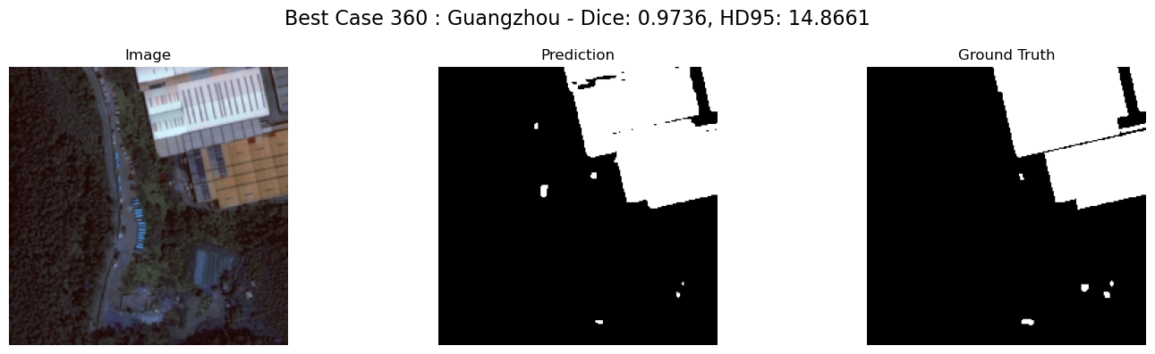
Top 5 Cases (Ignoring 0 & 1 Dice Scores)

Slide 29
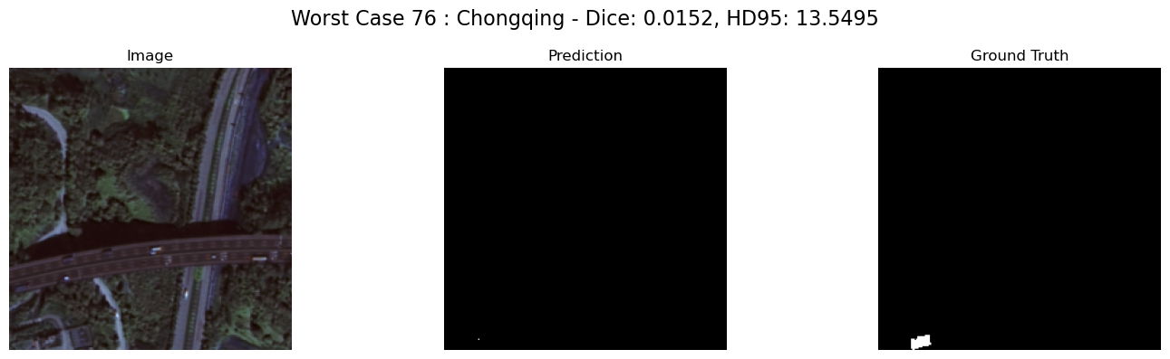
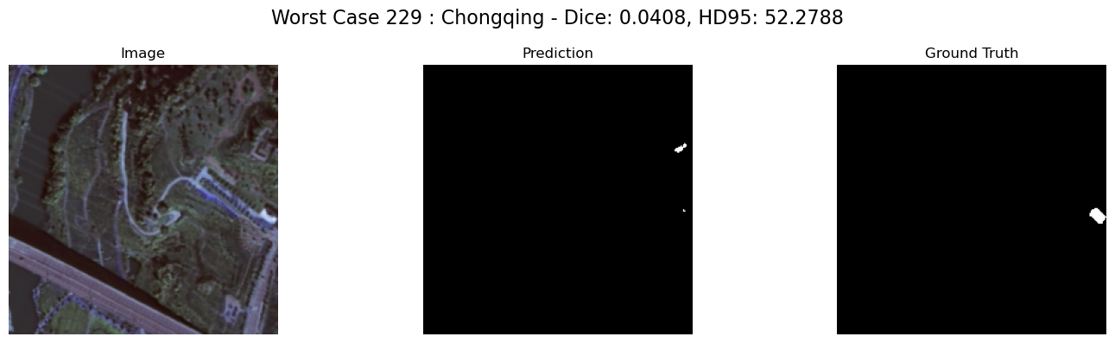
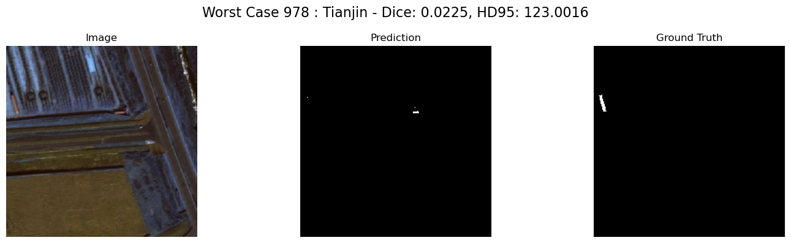
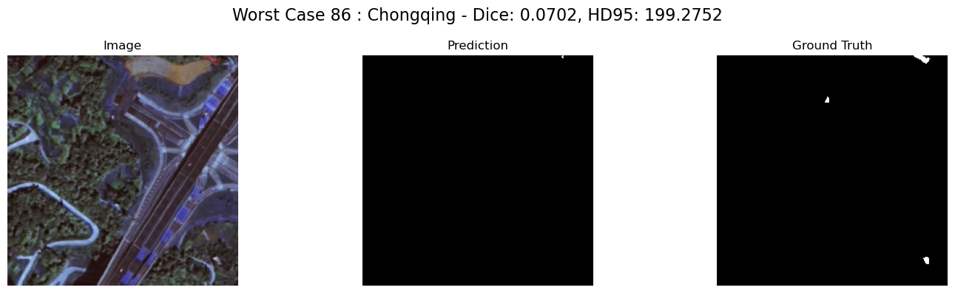
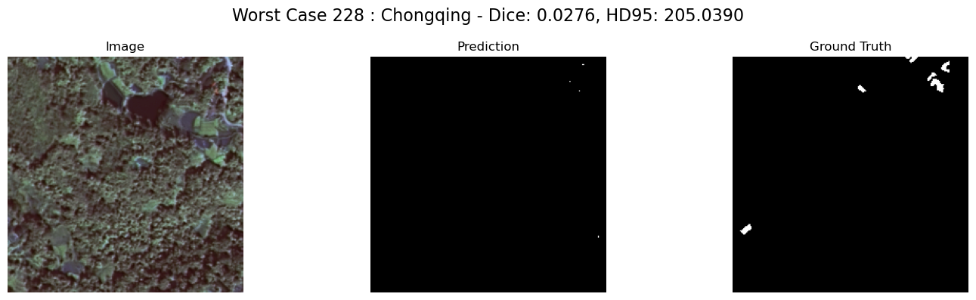
Bottom 5 Cases (Ignoring 0 & 1 Dice Scores)

Slide 30
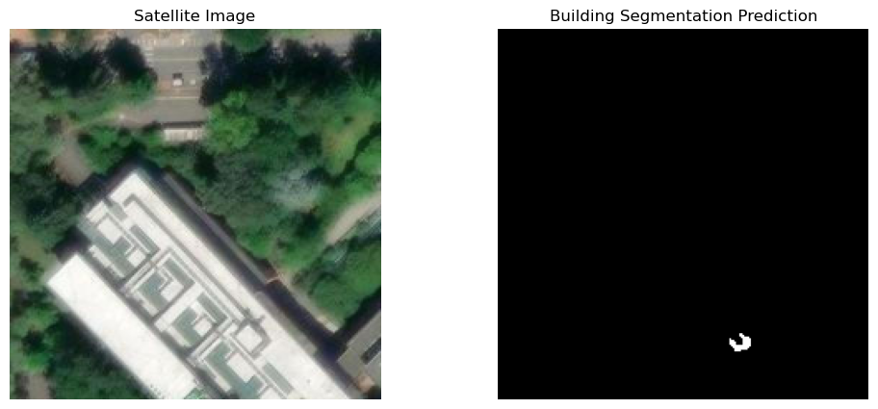
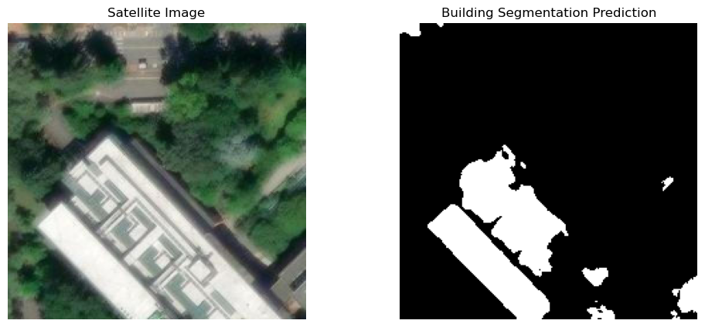
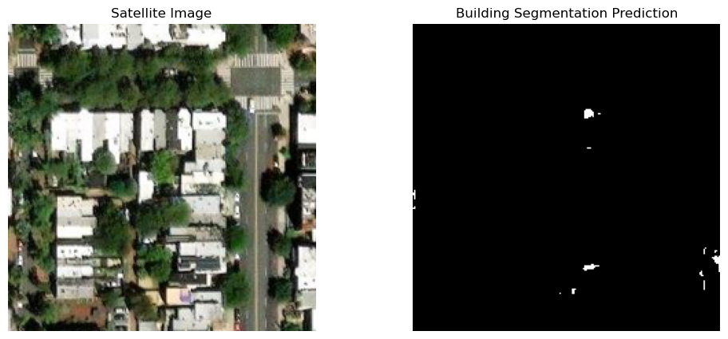

Looking at Performance of ArcGIS World Imagery
Model with only geometric transforms (rotation, flips)
Model with Geometric, Color Transformations, Noise
The Foster Building
Seattle, WA
Washington
DC

Slide 31




Looking at Performance of ArcGIS World Imagery
Model with only geometric transforms (rotation, flips)
Model with Geometric, Color Transformations, Noise
Pho Kham
Laos
Fez
Morrocco

Slide 32

Insights

Slide 33

Discussion & Insights
Overall Performance is strong in Dense Urban Areas however the model struggles with false positives in areas / patches with limited or no buildings e.g. Rural Settings
Potentially could be the result of our Hybrid Approach where the Transformer’s Global Attention is able capture more long rang dependencies and contextual cues, allowing the model to better differentiate building in dense urban areas with grids and more repeated patterns — though this advantage appears less pronounced in sparsely built rural areas.
Performance across different cities is consistent, there doesn’t seem to be any major differences
Augmentations Require Careful Tuning: Aggressive data augmentations degraded performance, while simpler geometric transforms (e.g. flips, rotations) improved performance on the Test Set but harmed wider generalizability
Notes:
Let's move on to our insights. Overall, our model perform well in dense urban areas but struggles with false positive in areas with limited or no buildings. For example, the rural area. And the main reason is that our transformer's global attention is able to capture more long rang dependencies and contextual cues, allowing the model to better differentiate building in dense urban areas with grids and more repeated patterns --- though this advantage appears less pronounced in rural areas.
The model performance the same across different cities.
Another insight we have is when we try to augment our model. If we just alter the angle of the image, it may improve the performance of the model on one sinigle test set. But eventually it will be a catastrophy for generalizing the results.

Slide 34

Limitations
Limited Datasets: The model was trained and evaluated on a single satellite imagery dataset (GaoFen-7) which is already extremely clean with images only from China thus acts to limit its generalizability across different geographies, sensor types, and architectural styles
High Computational Demand: Training required significant time and memory resources, which may hinder scalability and real-world deployment, especially on limited hardware
Rural Underrepresentation: The dataset contains limited amounts rural imagery, introducing potential bias and contributing to poor performance in low-density or building-scarce regions
Model Performance isn’t State of the Art or the best
Notes:
The limitation we have is that we directly taken the satellite imagery dataset from GaoFen-7. And it's already clean data from some major cities in China. We try couple raw images like the example we show early the forster building. We are generating descent results but not as good as the clean data set we have with GF-7. Another limitations we recognize is the high computational demeand. Training required signifiant time and memory resources, which may hinder scalability and applying to the real-world, especially on limited hardware. Rural underrepresentation is another limitation because our data set is only extract from urban area. We have a shortage on rural imagery. Again, our model is not the best and we still have a lot to improve compared to the leading model.

Slide 35

Future Work
Train on More Diverse Datasets: Incorporate satellite imagery from multiple sources and regions (e.g., Rural Home Annotation Dataset, SpaceNet 2) to improve generalizability across urban and rural areas and in different countries and geographies
Explore Alternative ViT Architectures: Experiment with lightweight and efficient transformer variants like MobileViT to reduce computational cost or Transformers Like SWIM to See if it improves Performance
Conduct Ablation Studies: Systematically evaluate the contribution of each model component (e.g., encoder type, skip connections, loss functions) to overall performance
Refine and Improve the Model: The Current model is basically only a proof of concept and in many ways a hack job solution, there is a lot of areas to trim weight and improve overall efficiency
Assess Fairness Across Different Contexts: Introduce fairness metrics to evaluate performance disparities between urban and rural areas
Notes:
So what's our nest step. We are gonna train our model on more diverse datasets, By diverse, what we mean is to train dataset not just from China and not just from urban area.
In case of model and transformer, we are gonna explore alternative Vision transformers, we plan to experiment with some lightweight transformer such as Mobile Vit. And this will reduce our cost. And we may use LoRA adapter or other adapter to reduce the parameters and eventually reduct training cost. Next, we are gonna dive deeper into evaluating framework, we will systematically evaluate the contribution of each model component to overall performance. And we will also refine and improce the model, right now it’s more like a prototypign model, we may build a interface for the model for end users to input satelitte imagery. TO make it prettier. Last but not least, and I think this is the most important is we decide to assess fairness across different contexts, reducing any allocation harms or quality of service harms. For example, people who live in the rural area how do we improve our quality of service for them. And we will prevent biases based on the equalized odds fairness metrics.

Slide 36

Conclusion
Our Hybrid – U Net Model prototype overall performs well compared to (at least in line with) other Building Segmentation Models
Achieved strong segmentation performance, particularly in dense urban environments but struggled with False Positives in areas with no or a Limited Number of buildings
Data augmentations made a significant differences in improving performance and overall generalizability
Optimizer and scheduler choices (AdamW + AMSGrad, CosineAnnealingWarmRestarts) significantly improved training stability (especially Training Time) and convergence
Our Results suggest that hybrid architectures can be promising for large-scale, diverse-region mapping, especially in underrepresented area
Notes:
That brings us to our conclusion, Our hybrid u-net model prototype overall performs weel compared to other leading building segmentation models. We Achieved strong segmentation performance, particularly in dense urban environments but struggled with False Positives in areas with no or a Limited Number of buildings.
Our data augmentation strategies really make a significant differences in improving performance and overall generalization.
The optimizer we end up with AdamW with AMSGrad, and the scheduler end up with cosine annealingwarm restarts significantly improved training stability and convergence. And our results suggest that hybrid architectures can be promising for large-scale, diverse-region mapping, especially in underrepresented area.

Slide 37

Thank You
Final Project Presentation
Irti Haq, Youngkyu Ko,
Xunan Li

Slide 38

Q&A
Questions & Answers

Slide 39
Reference
Chen, J., Lu, Y., Yu, Q., Luo, X., Adeli, E., Wang, Y., & Zhou, Y. (2021). TransUNet: Transformers make strong encoders for medical image segmentation. arXiv preprint arXiv:2102.04306. https://arxiv.org/abs/2102.04306
Dosovitskiy, A., Beyer, L., Kolesnikov, A., Weissenborn, D., Zhai, X., Unterthiner, T., ... & Houlsby, N. (2020). An image is worth 16x16 words: Transformers for image recognition at scale. arXiv preprint arXiv:2010.11929. https://arxiv.org/abs/2010.11929
Chen, P., Huang, H., Ye, F., Song, Q., & Wang, H. (2024). A benchmark GaoFen-7 dataset for building extraction from satellite images. Scientific Data, 11(187). https://doi.org/10.1038/s41597-024-03009-5
Buslaev, A., Iglovikov, V. I., Khvedchenya, E., Parinov, A., Druzhinin, M., & Kalinin, A. A. (2020). Albumentations: Fast and flexible image augmentations. Information, 11(2), 125. https://doi.org/10.3390/info11020125
Paszke, A., Gross, S., Massa, F., Lerer, A., Bradbury, J., Chanan, G., ... & Chintala, S. (2019). PyTorch: An imperative style, high-performance deep learning library. In Advances in Neural Information Processing Systems (Vol. 32). https://papers.nips.cc/paper_files/paper/2019/file/bdbca288fee7f92f2bfa9f7012727740-Paper.pdf

